Slide 1

Elective - GIS Studio (GSS) (PG2) NASA WORLD WIND Europa Challenge 22.05.2017

Slide 2
Outline
Introduction
NASA WORLD WIND Europa Challenge 2017
Why Smart Pollen Monitoring?
Data Collection & Data model
Tree Data (Frankfurt)
Real-time Wind Data (OpenWeather)
Historical Wind Data (weatherspark.com)
Data Model Structure
Application architecture
…
…
Application Functionalities
Application Interface
Pollen Dispersal Analysis
Application Homepage
Live Demo
Summarize
Add Tree Function
Notes:
State of technology (overview about related research project and literature)
Concept
Technology used
Data used
Project plan and milestones
Expected outcome

Slide 3
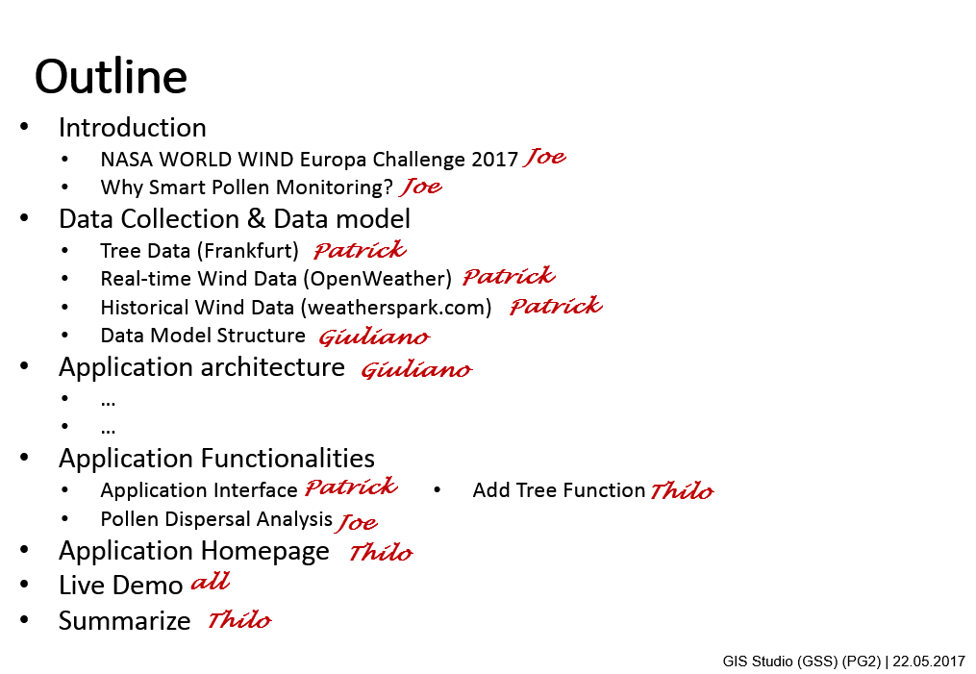
Outline with Responsible person

Slide 4


NASA WORLD WIND Europa Challenge
Solutions For Sustainable Cities!
The Europa Challenge is a world challenge, guided by Europe's INSPIRE Directive. We challenge you to bring the world closer together through urban management solutions that YOU build and share with every other city!
The Europa Challenge asks the world's *best and brightest* to develop solutions serving your local community needs that challenge every other city to do the same! And benefit each other with the results.

Slide 5
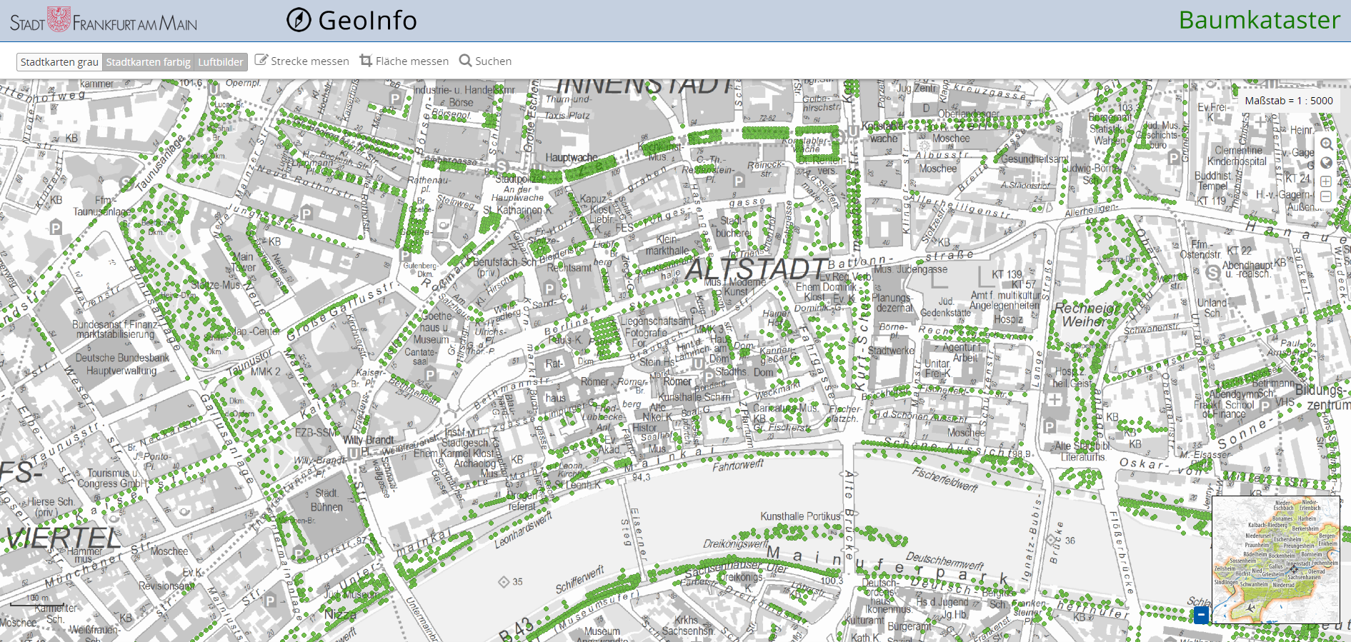
Data used – Tree data
Tree cadastre of the city of Frankfurt
http://www.offenedaten.frankfurt.de/dataset/baumkataster-frankfurt-am-main

Slide 6

Data used – Wind data

Slide 7




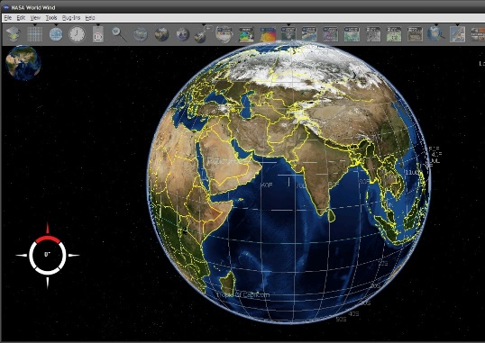



Software Architecture
Database
Server
Client
pg-promise
http / wss
WFS
http

Slide 8
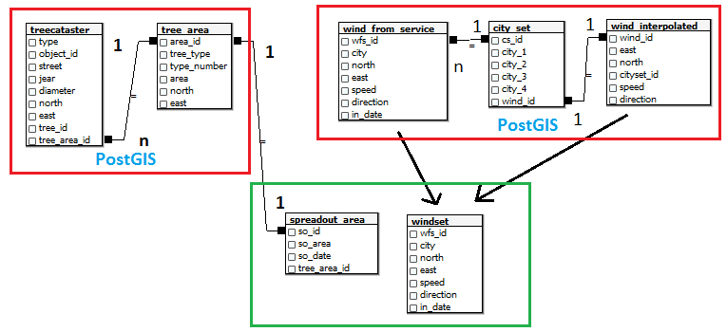

Data Model

Slide 9
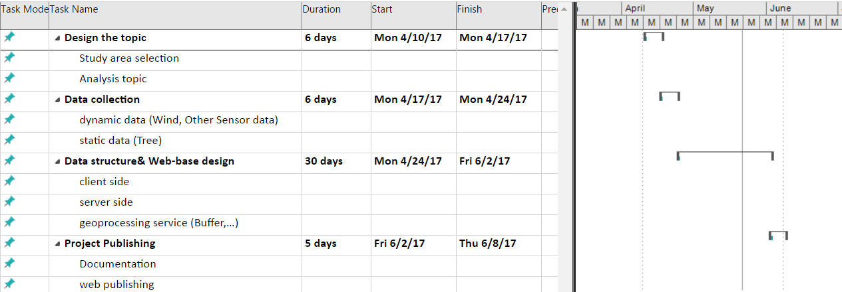
Project Plan

Slide 10
Discussion

